Slide 1

Exploratory data analysis: Crime data in Birmingham Aug 2020 – Jul 2023
By Kaj Kabilan
Darryl Hewitt
Mushfiqur Rahman
Suwaiba

Slide 2
Purpose of the project
Examine how different crimes vary throughout the year
Investigate whether deprivation play a factor in the crime rate
Determine seasonal patterns in crime/crime types
Determine locations with highest and lowest crime count
Data visualisation

Slide 3
Research Questions
What is the correlation between crime count and the Index of Multiple Deprivation (IMD) score? How does the type of crime relate to the IMD score?
What are the top 10 locations with the highest crime counts, and what are their corresponding IMD scores? Conversely, what are the 10 locations with the lowest crime counts, and what are their IMD scores?
Do crime rates exhibit seasonality, with lower street crime rates during winter months (November to February) compared to summer months (May to August)?
What are types and totals of street crime that occur in Birmingham?
Where are the local police stations situated?

Slide 4
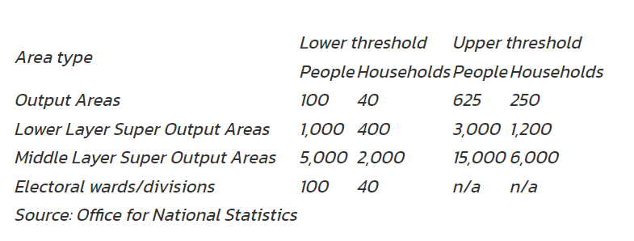
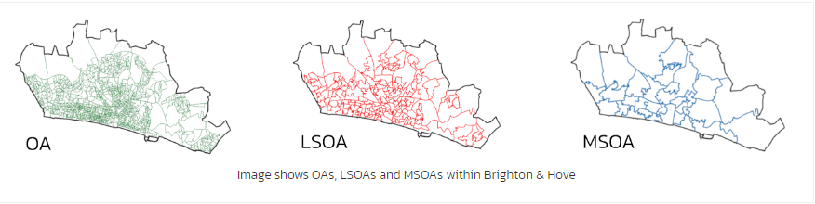
Lsoa and imd score
LSOA - Lower Layer Super Output Area
IMD - Index of Multiple Deprivation
IMD score is a composite measure and is created with 7 domains of deprivation: Income (22.5%), Employment (22.5%), Education (13.5%), Health (13.5%), Crime (9.3%), Barriers to Housing & Services (9.3%), and Living Environment (9.3%).

Slide 5
Data Cleaning and Preparation
Merging, Cleaning and Analysing data

Slide 6
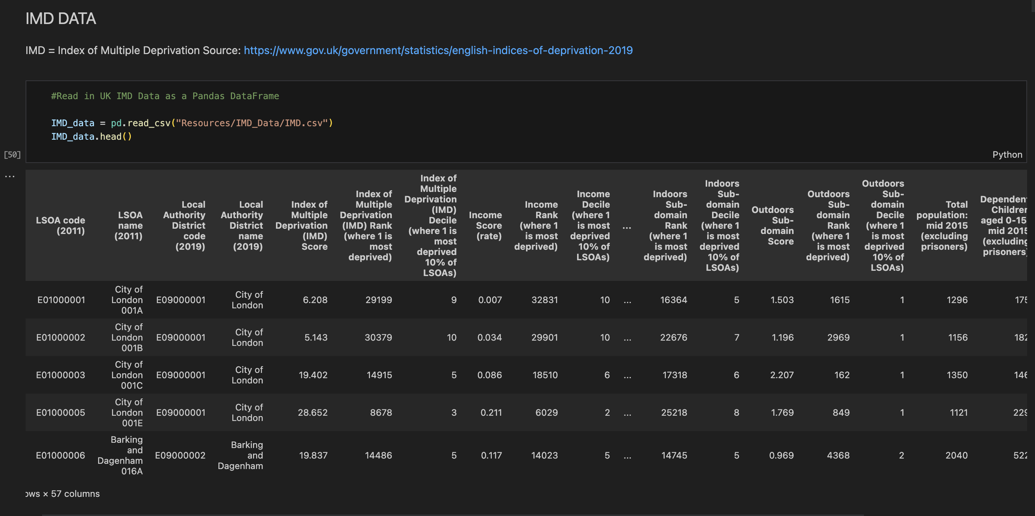
Merging and Cleaning data

Slide 7
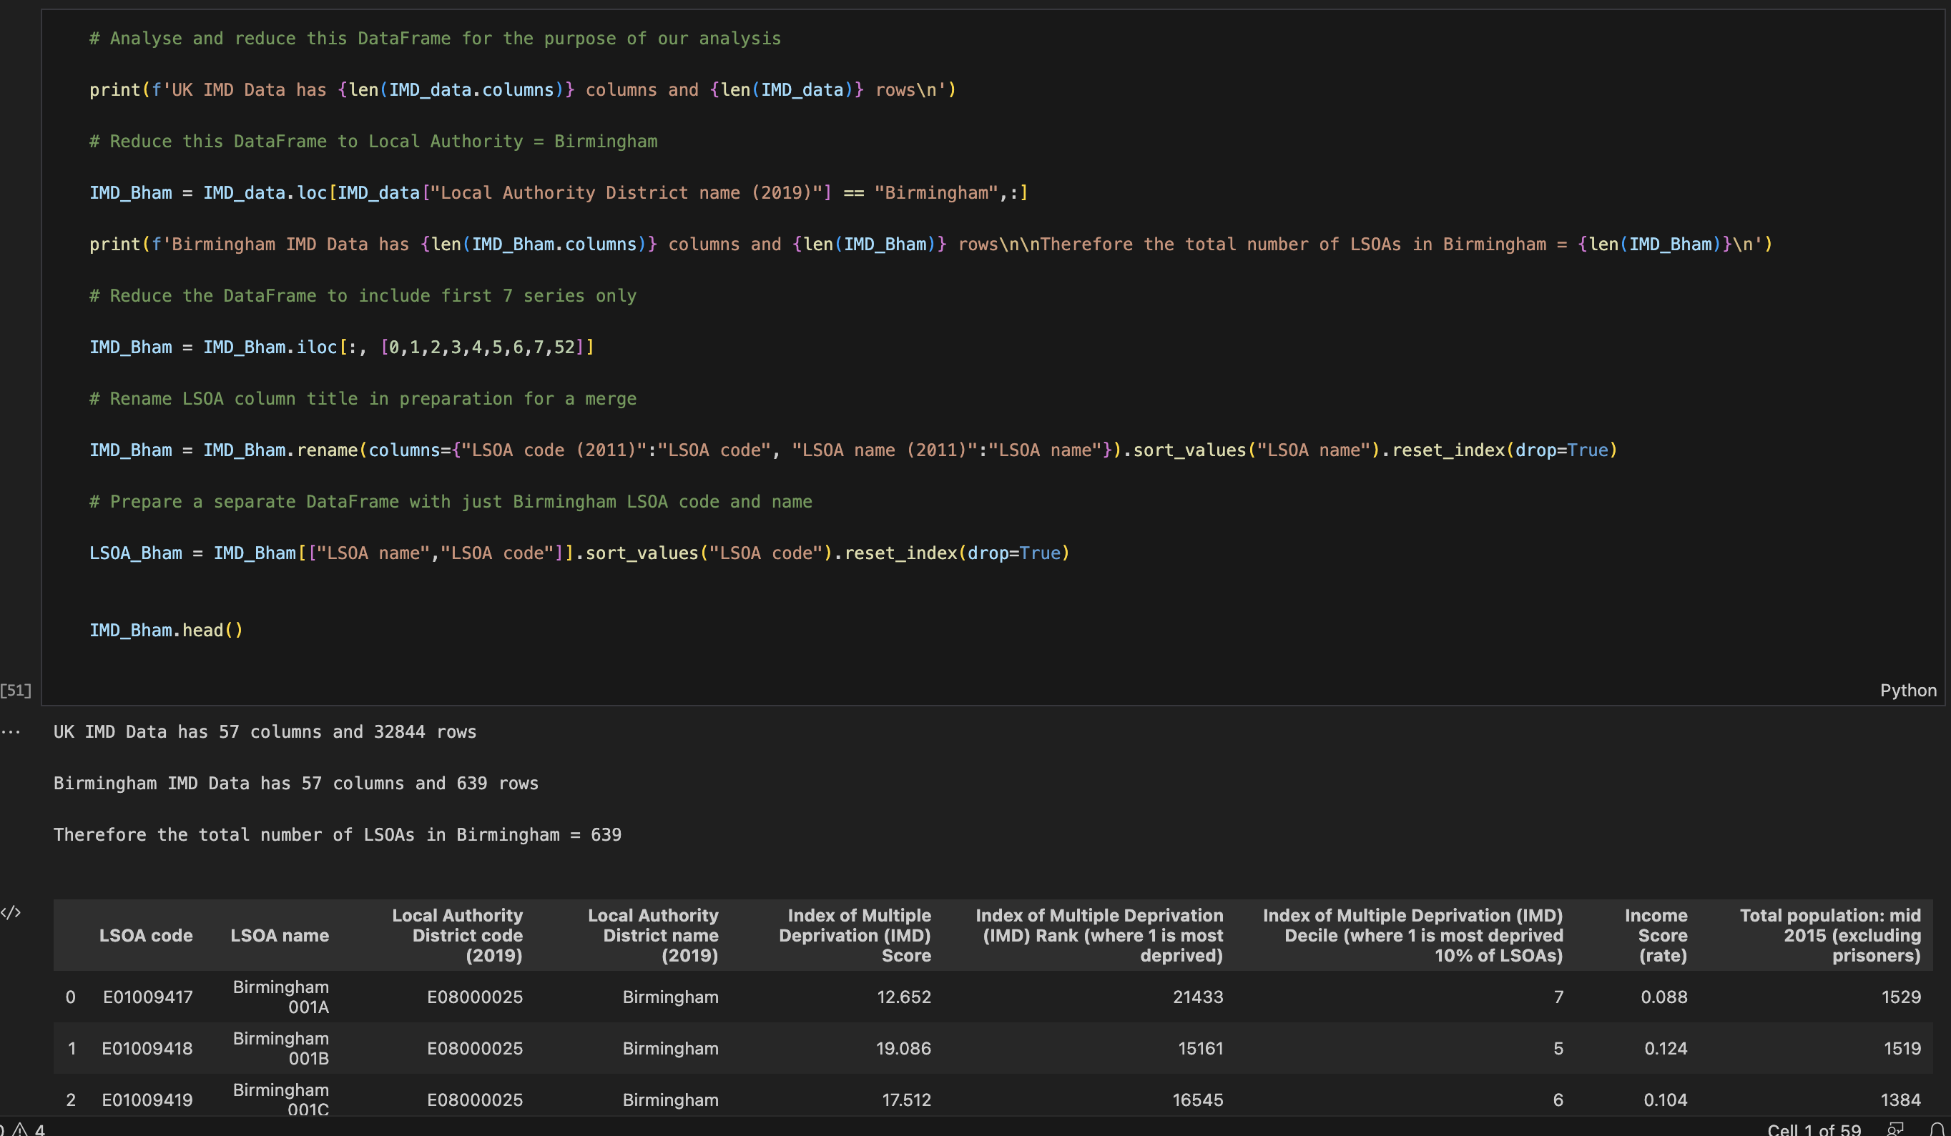
Merging and Cleaning data

Slide 8
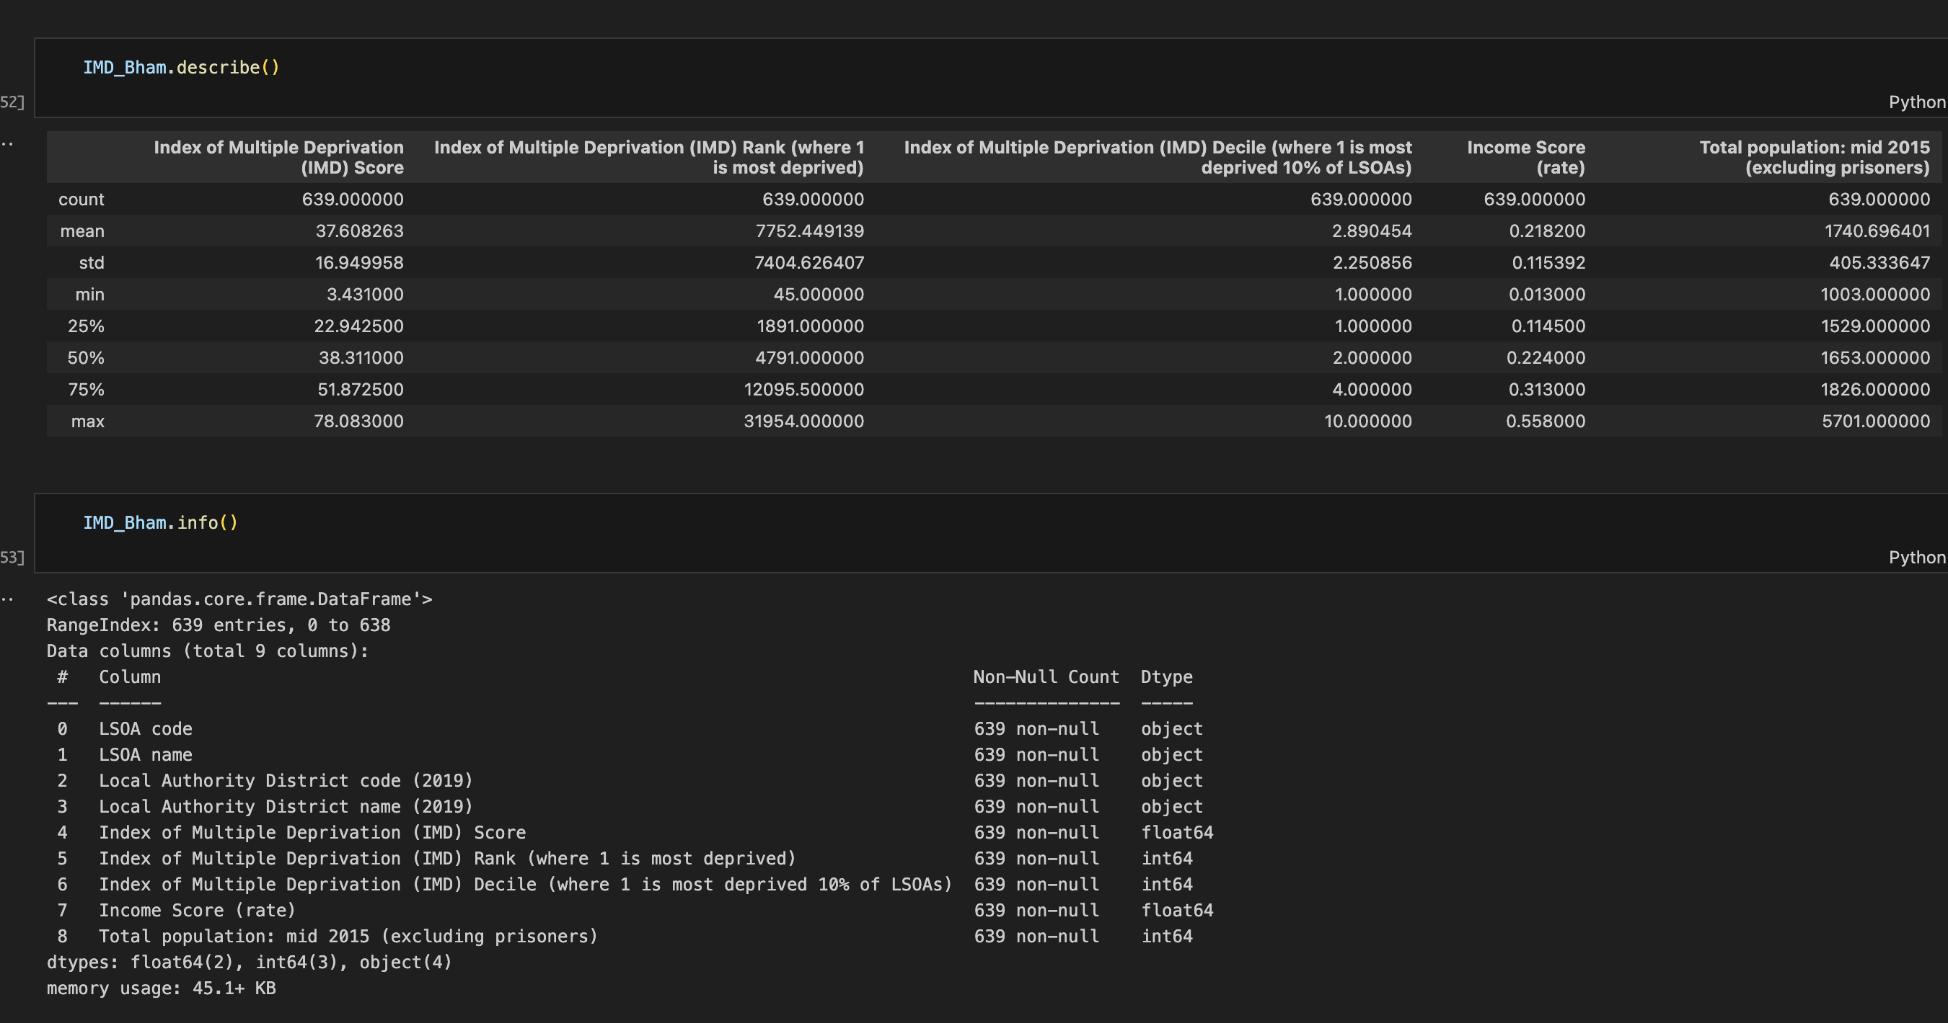
Merging and Cleaning data

Slide 9
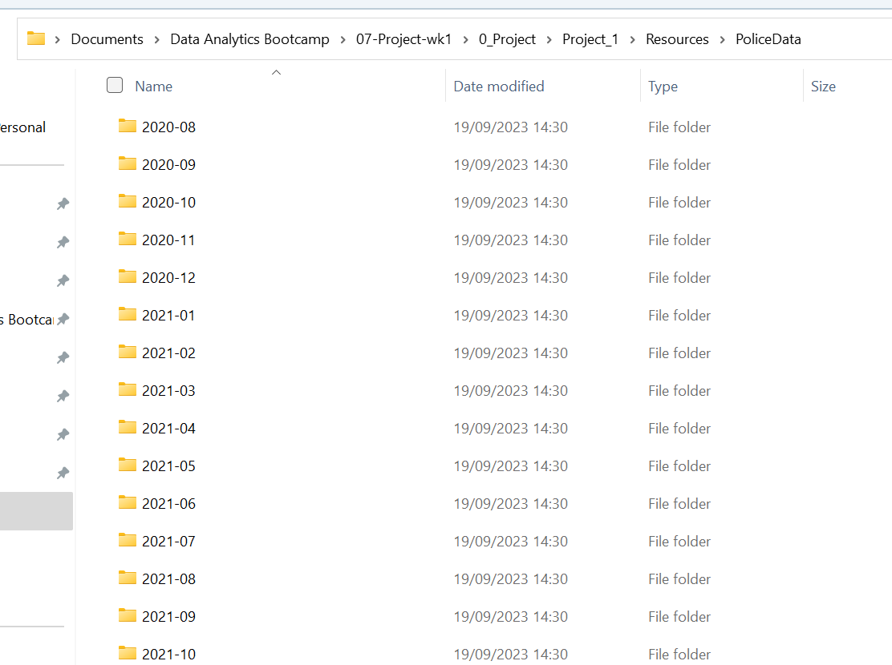
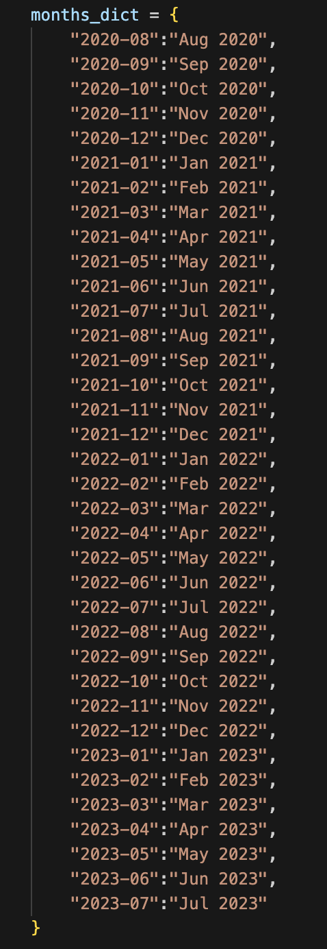
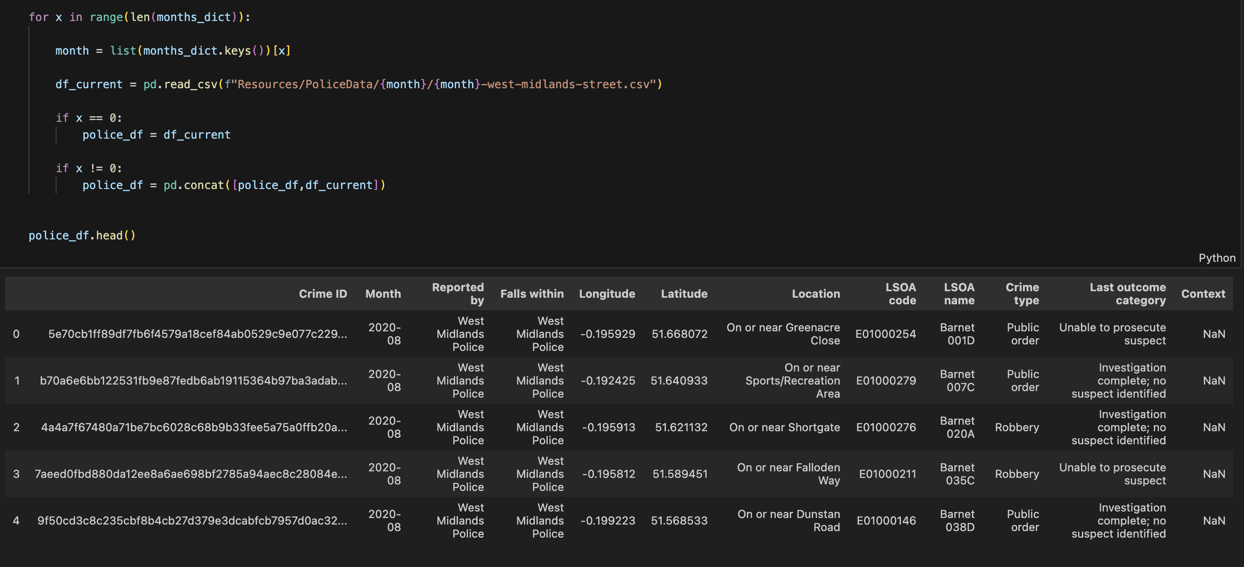
Police Data

Slide 10
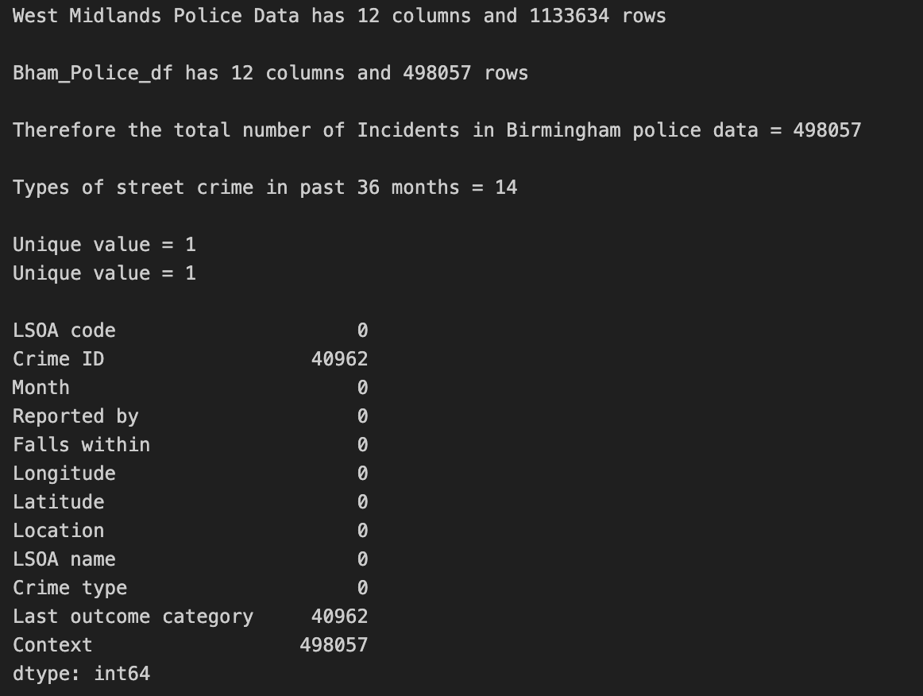
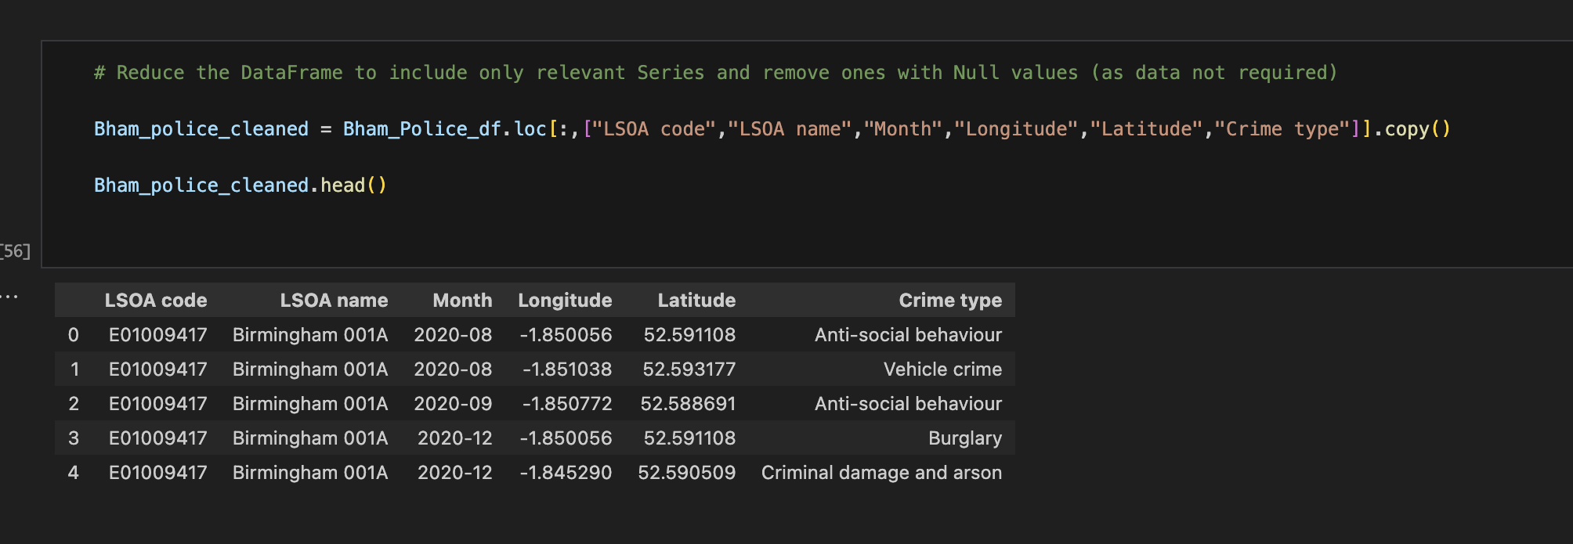
Police Data

Slide 11
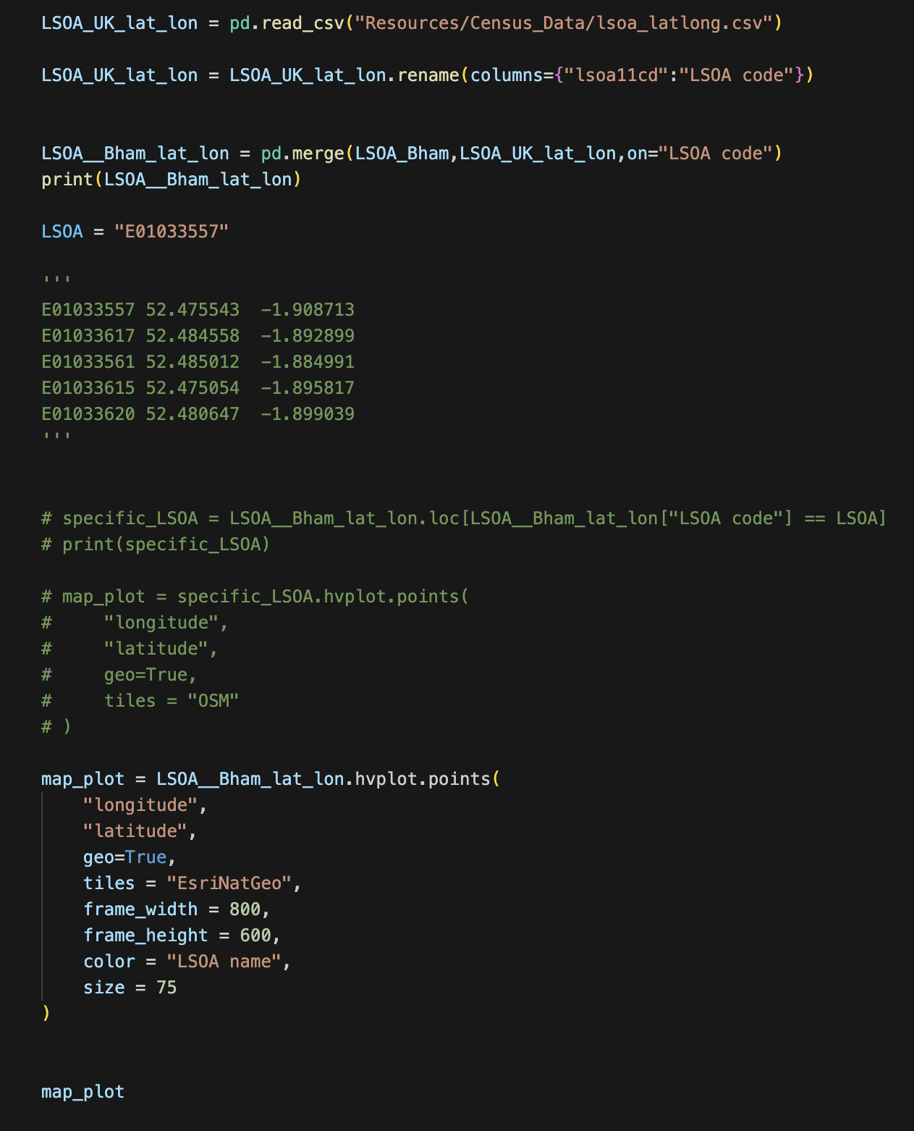
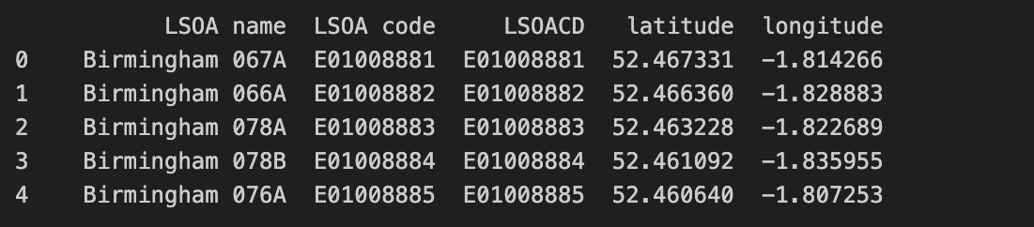
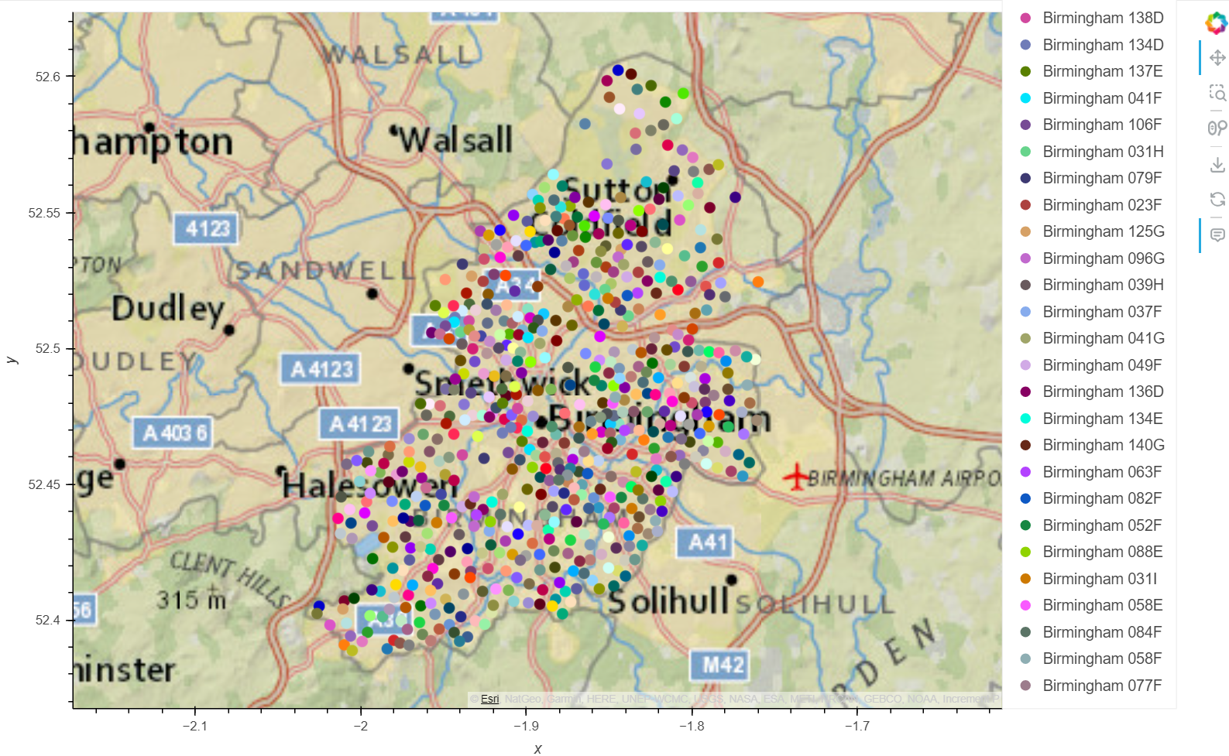
LSOA Map Plot

Slide 12

Research Question 1
What are types and totals of street crime that occur in Birmingham?
Where are the local police stations situated?
Hypothesis: The most occurring crime type in Birmingham will be robbery

Slide 13
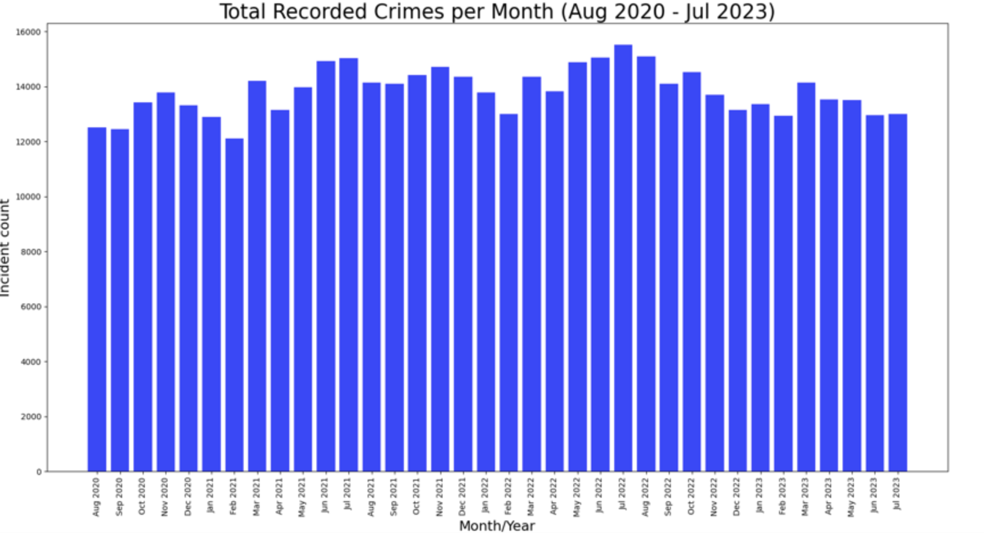
Summary data

Slide 14
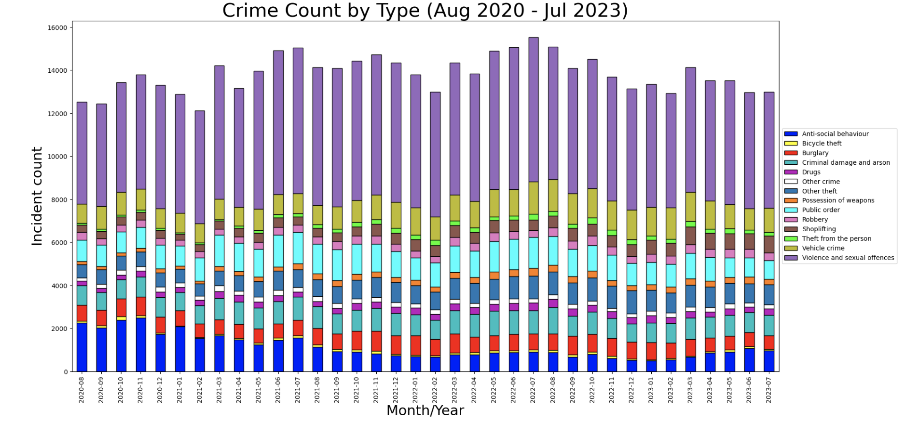

Slide 15
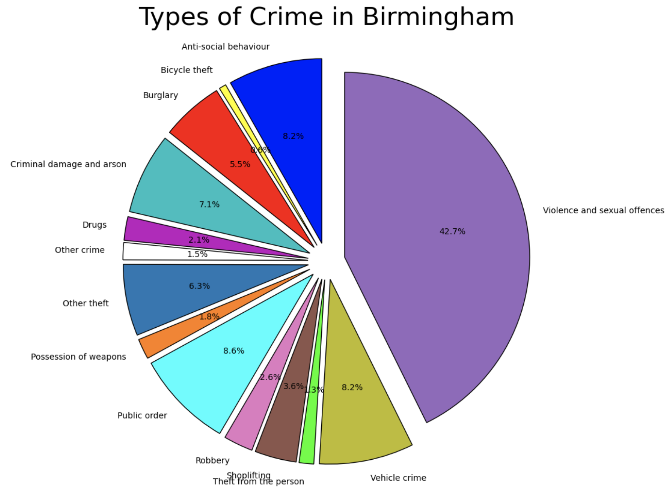

Slide 16
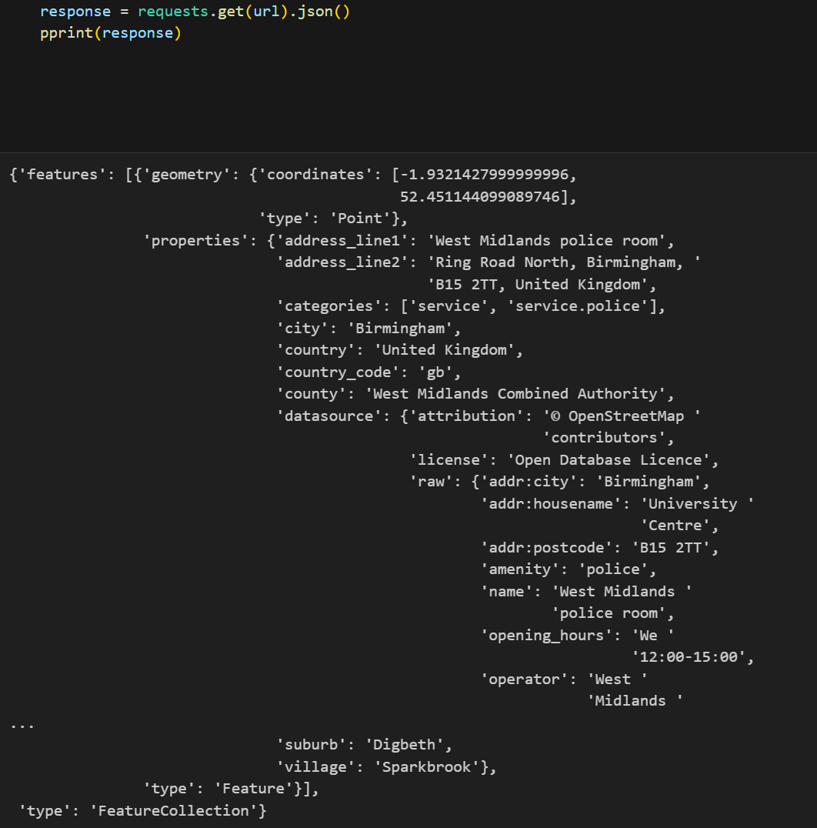
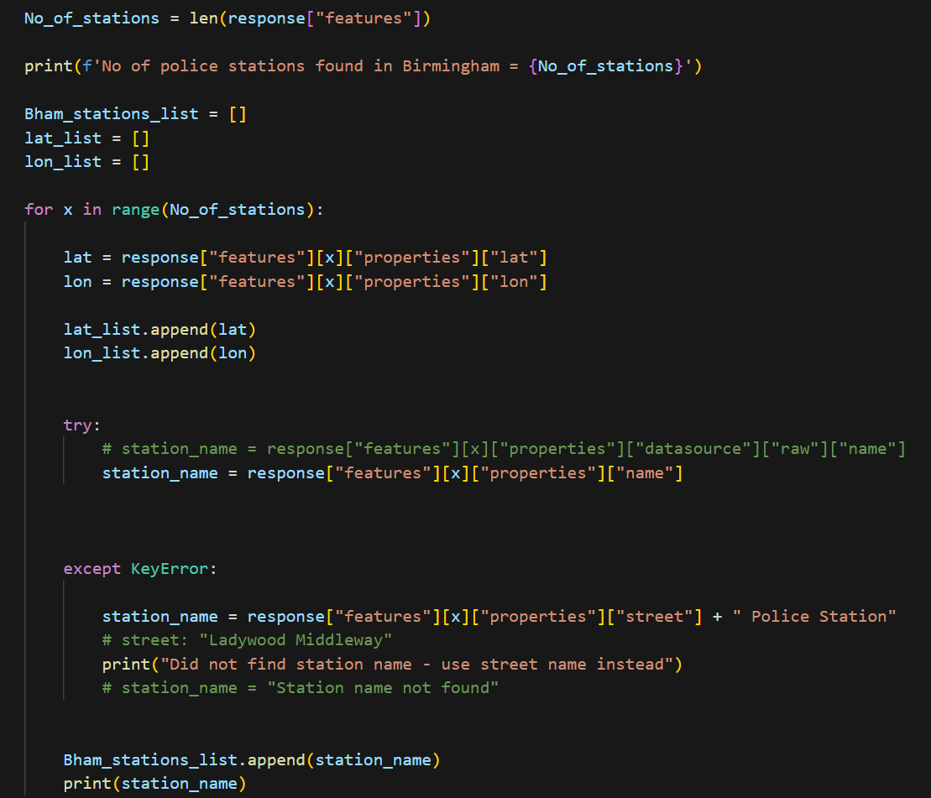
Geoapify Police stations

Slide 17
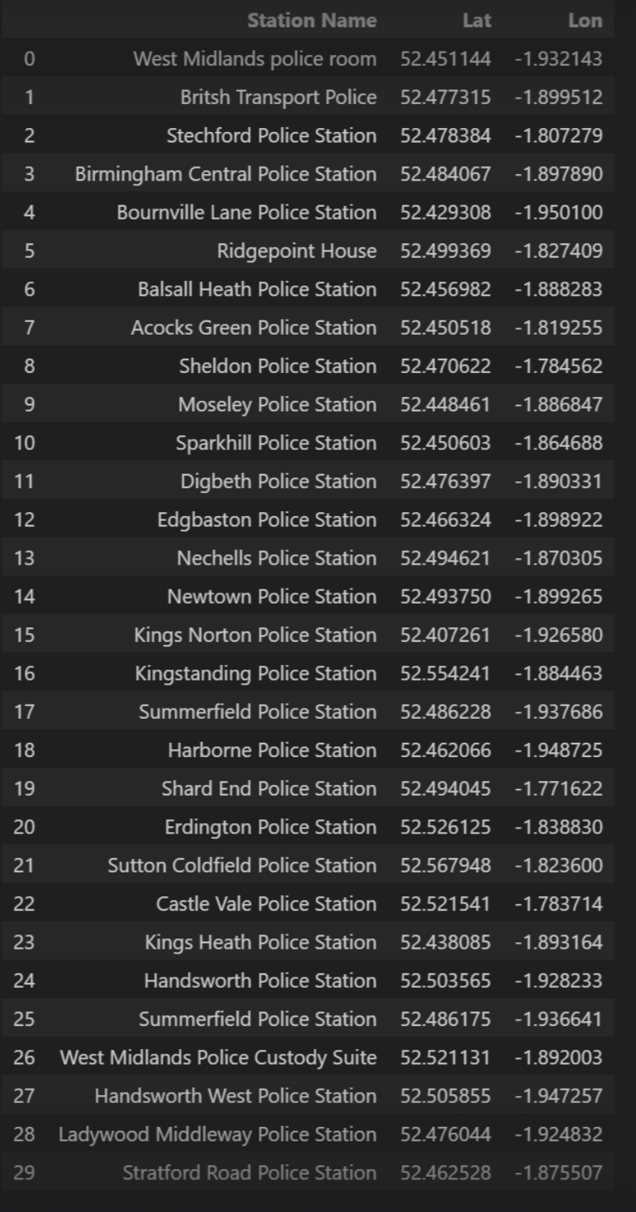
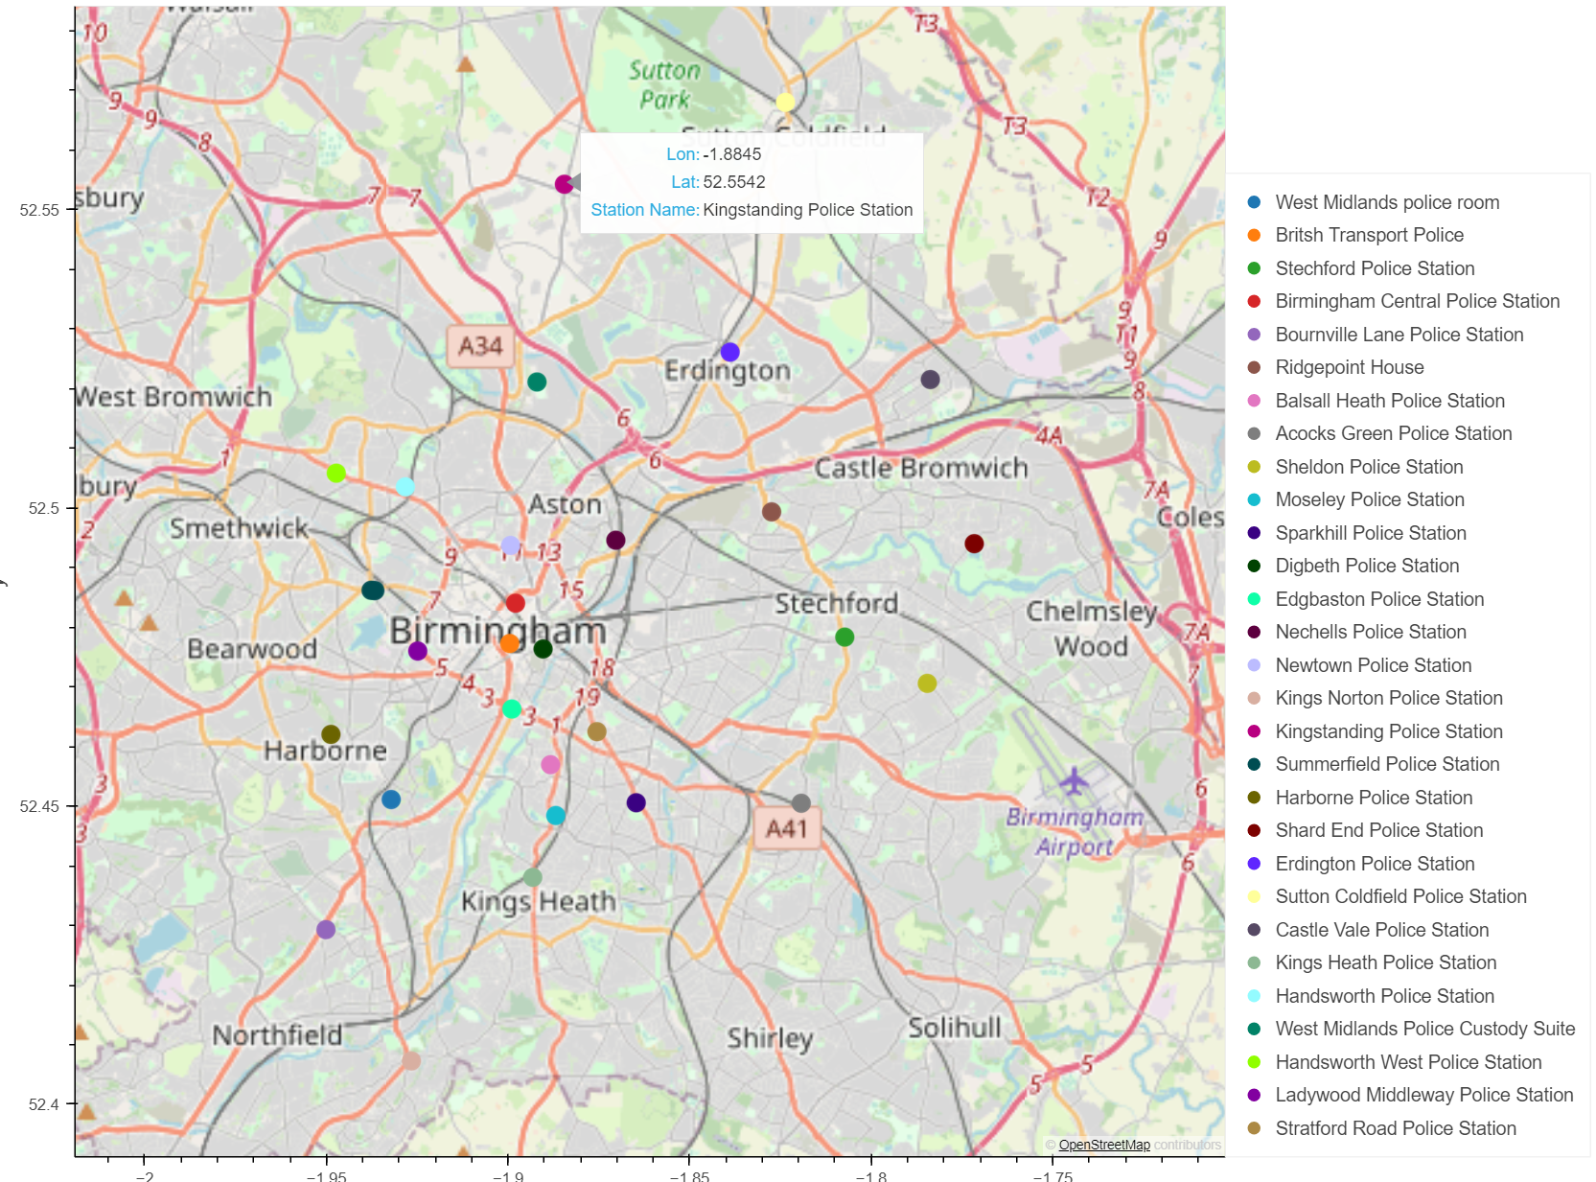
This data set was gathered using Geoapify Places API

Slide 18
Research Question 2
What is the correlation between crime count and the Index of Multiple Deprivation (IMD) score? How does the type of crime relate to the IMD score?
Hypothesis: There is a significant correlation between crime count and the Index of Multiple Deprivation (IMD) score.

Slide 19
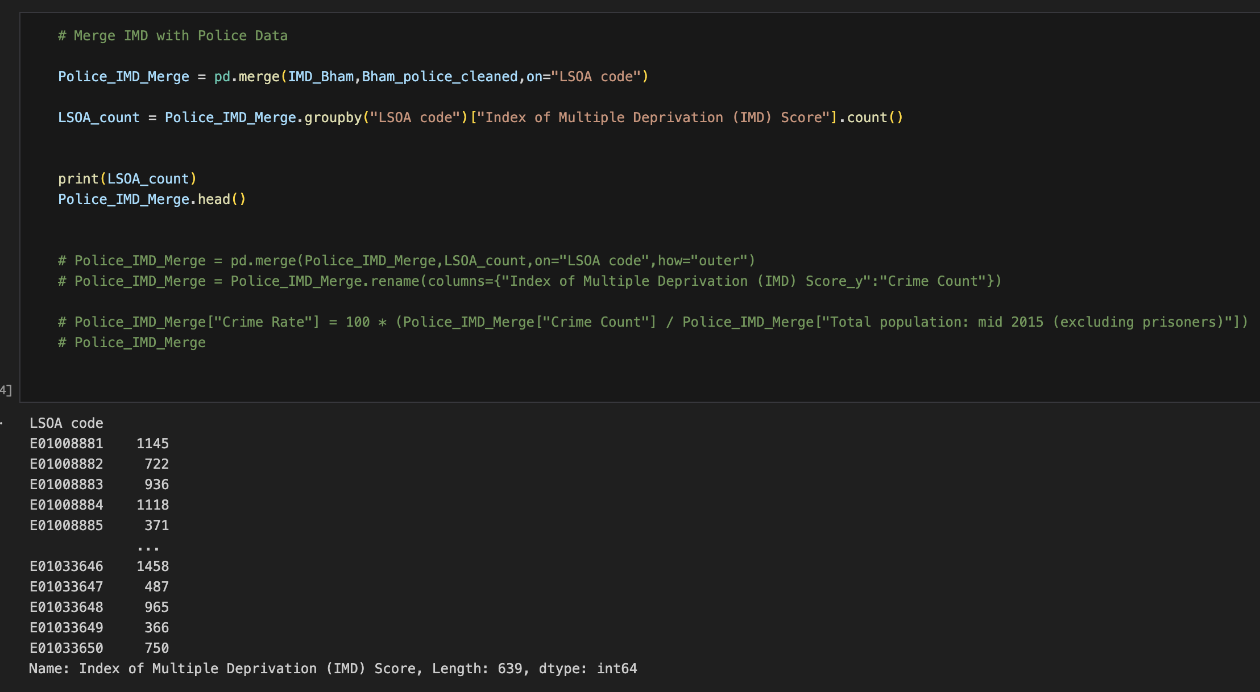
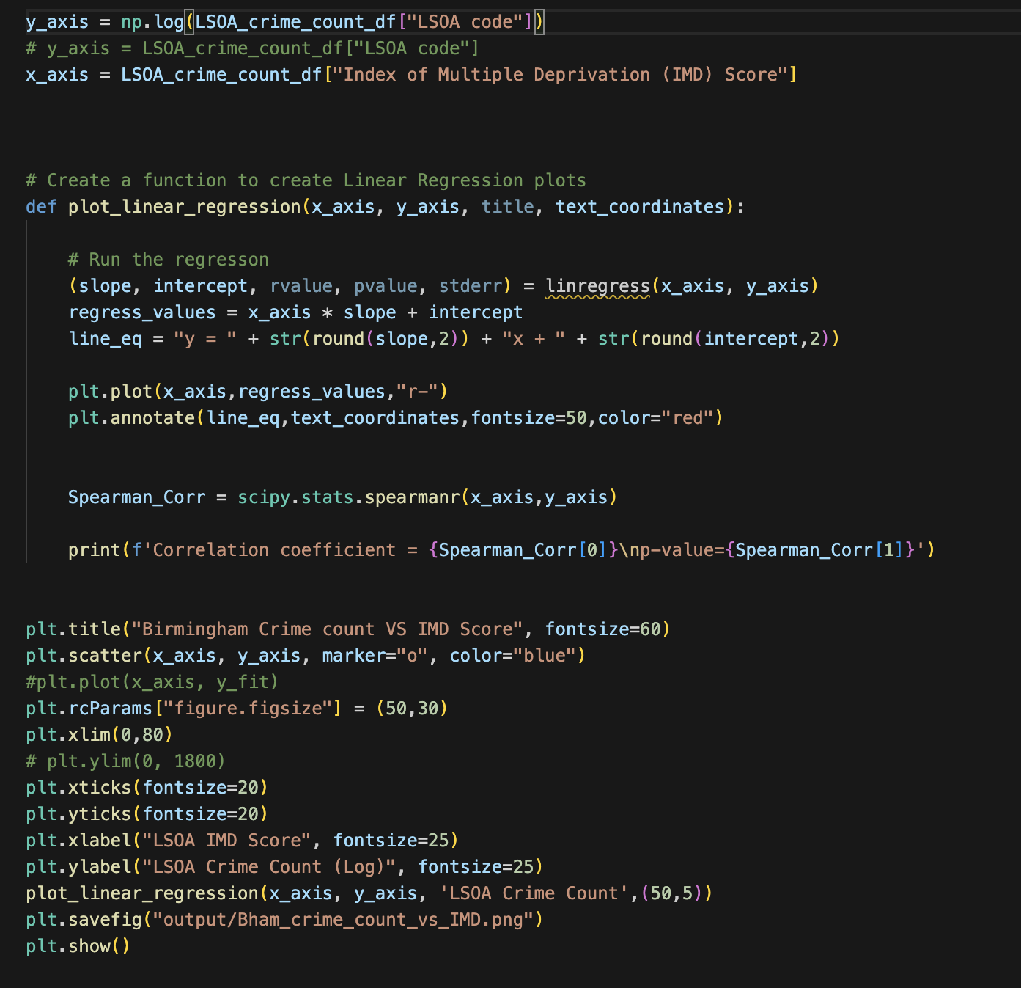
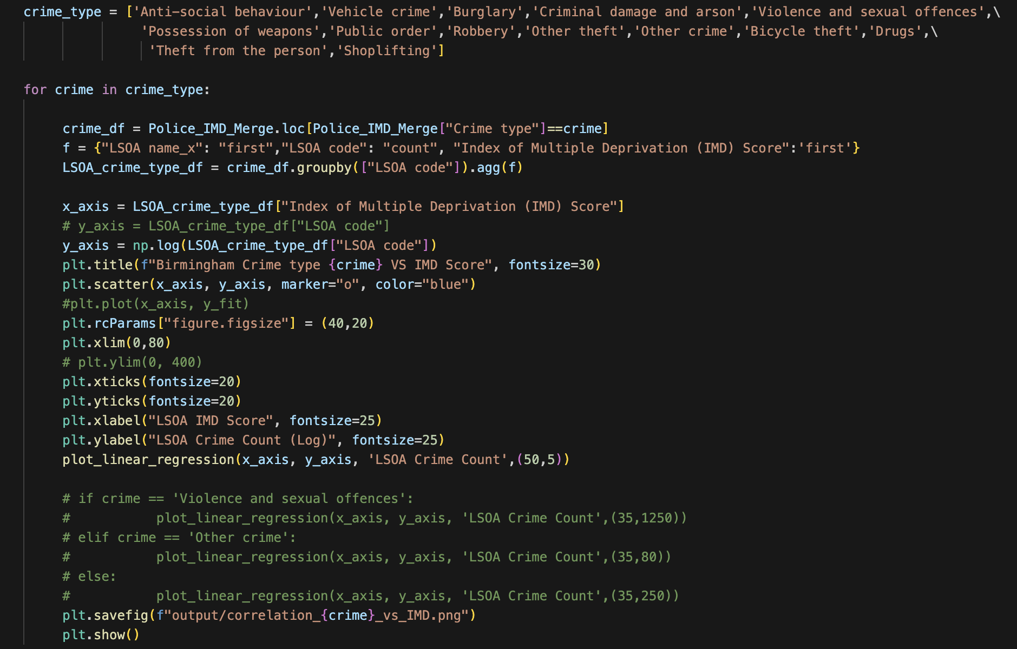
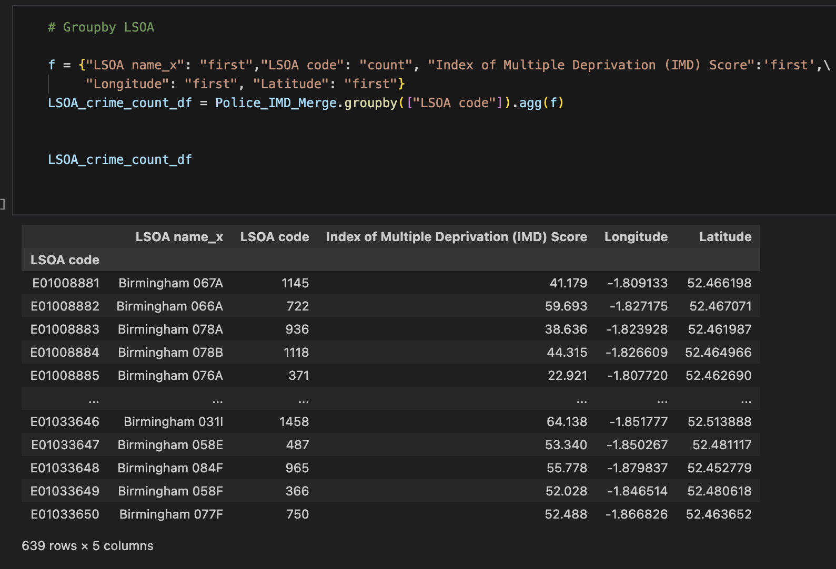
Data analysis process

Slide 20
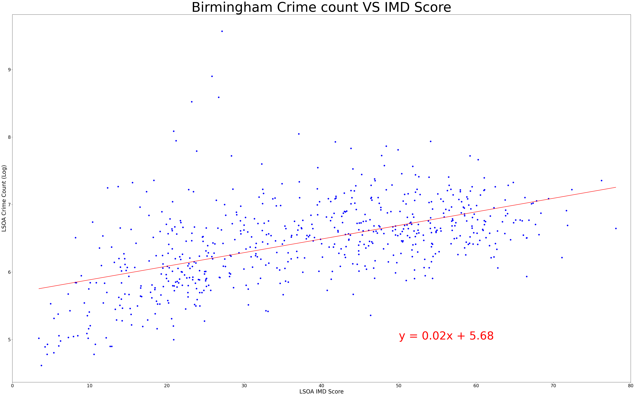
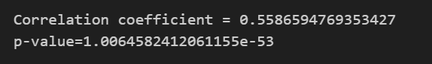

Slide 21
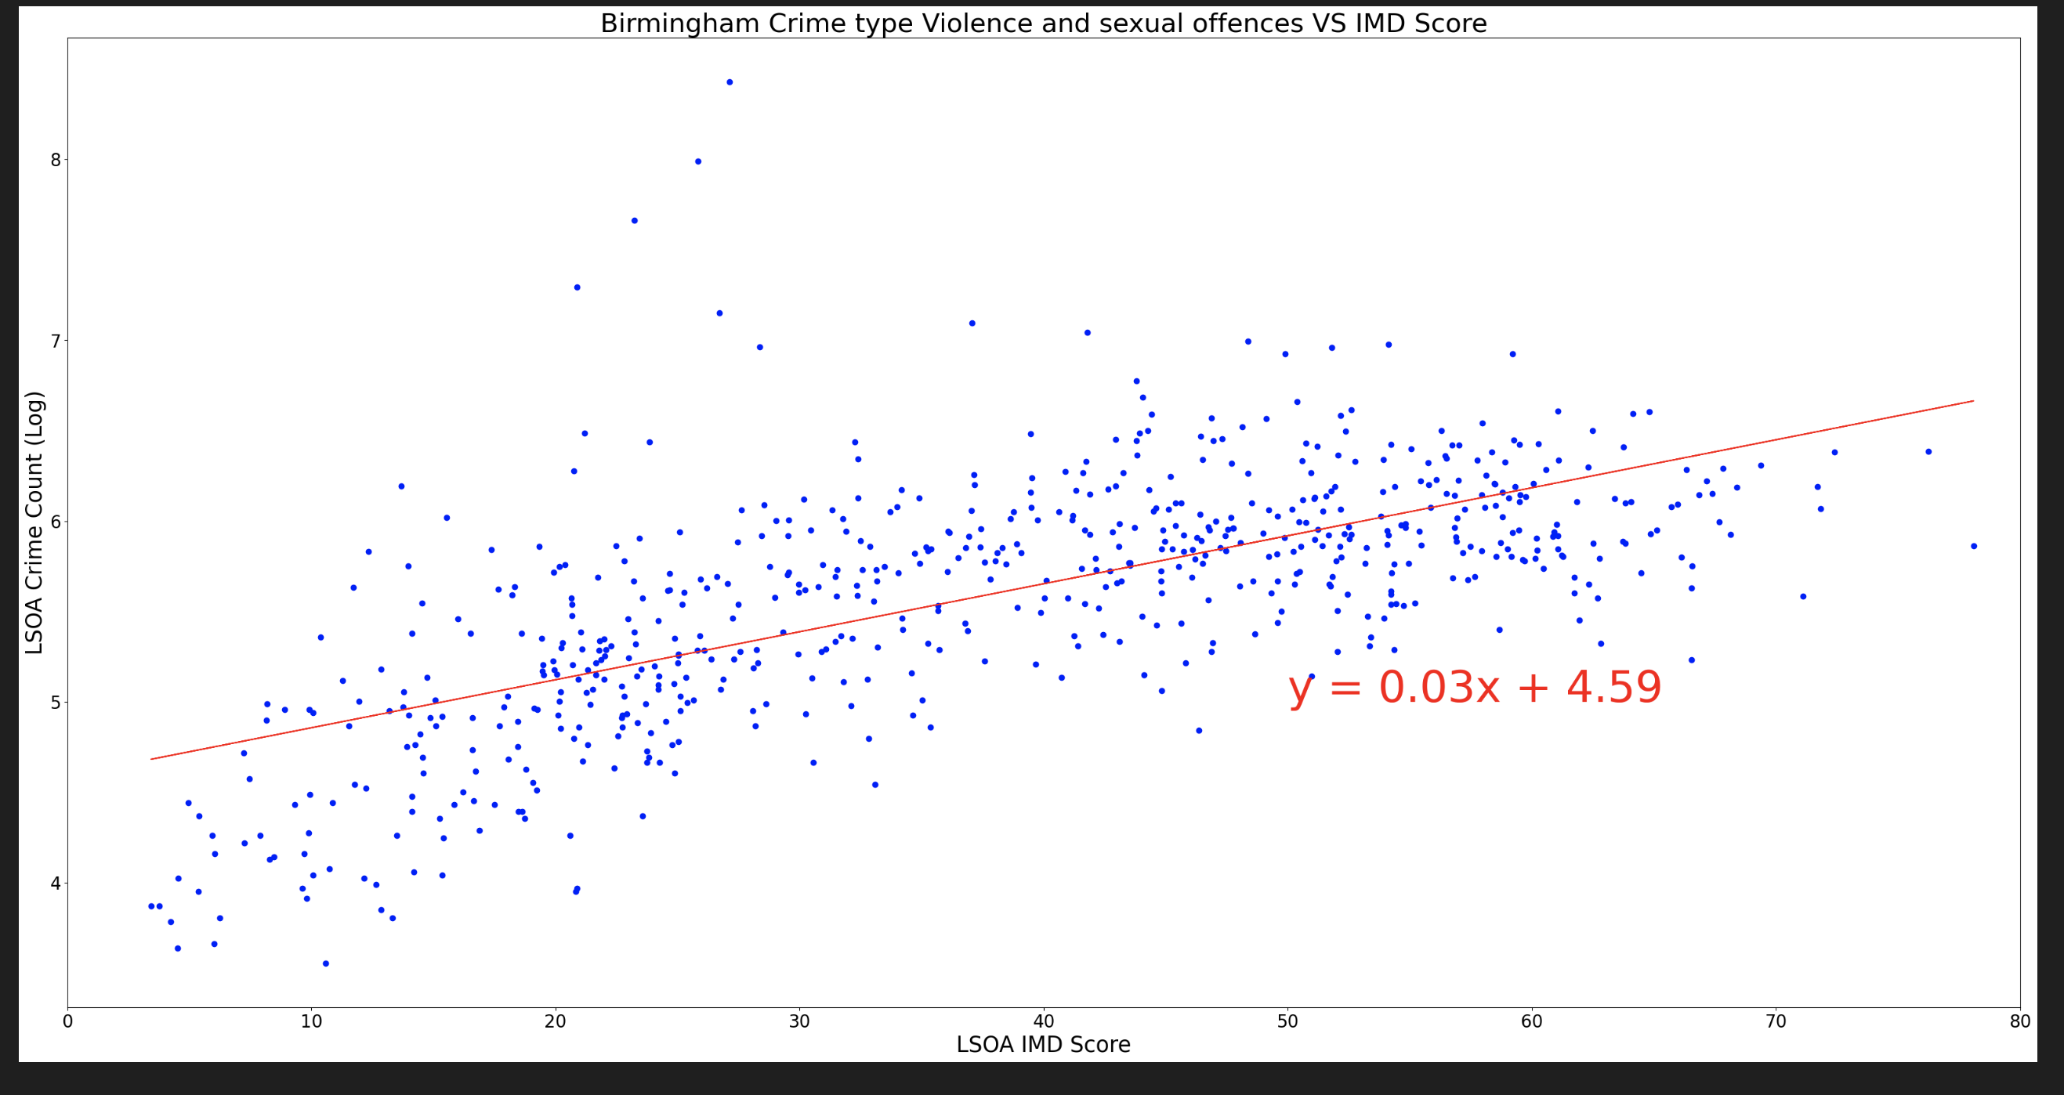
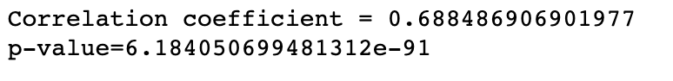

Slide 22
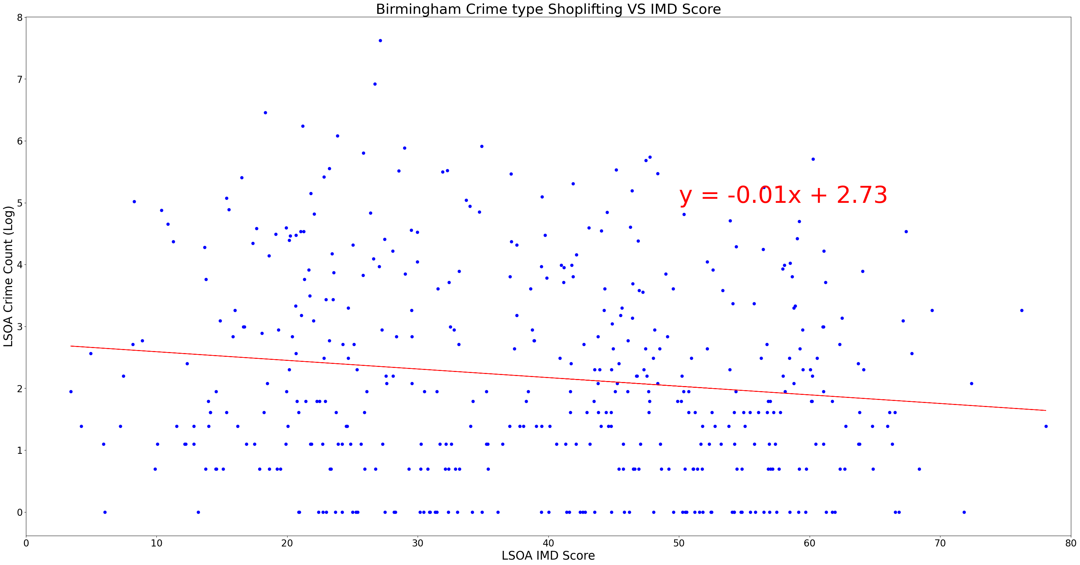
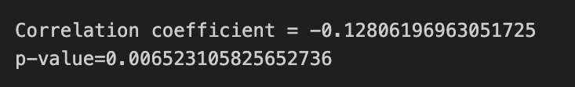

Slide 23
Research Question 3
What are the top 10 locations with the highest crime counts, and what are their corresponding IMD scores? Conversely, what are the 10 locations with the lowest crime counts, and what are their IMD scores?
Hypothesis: The top 10 locations with the highest crime counts will have lower IMD scores, showing higher levels of deprivation

Slide 24
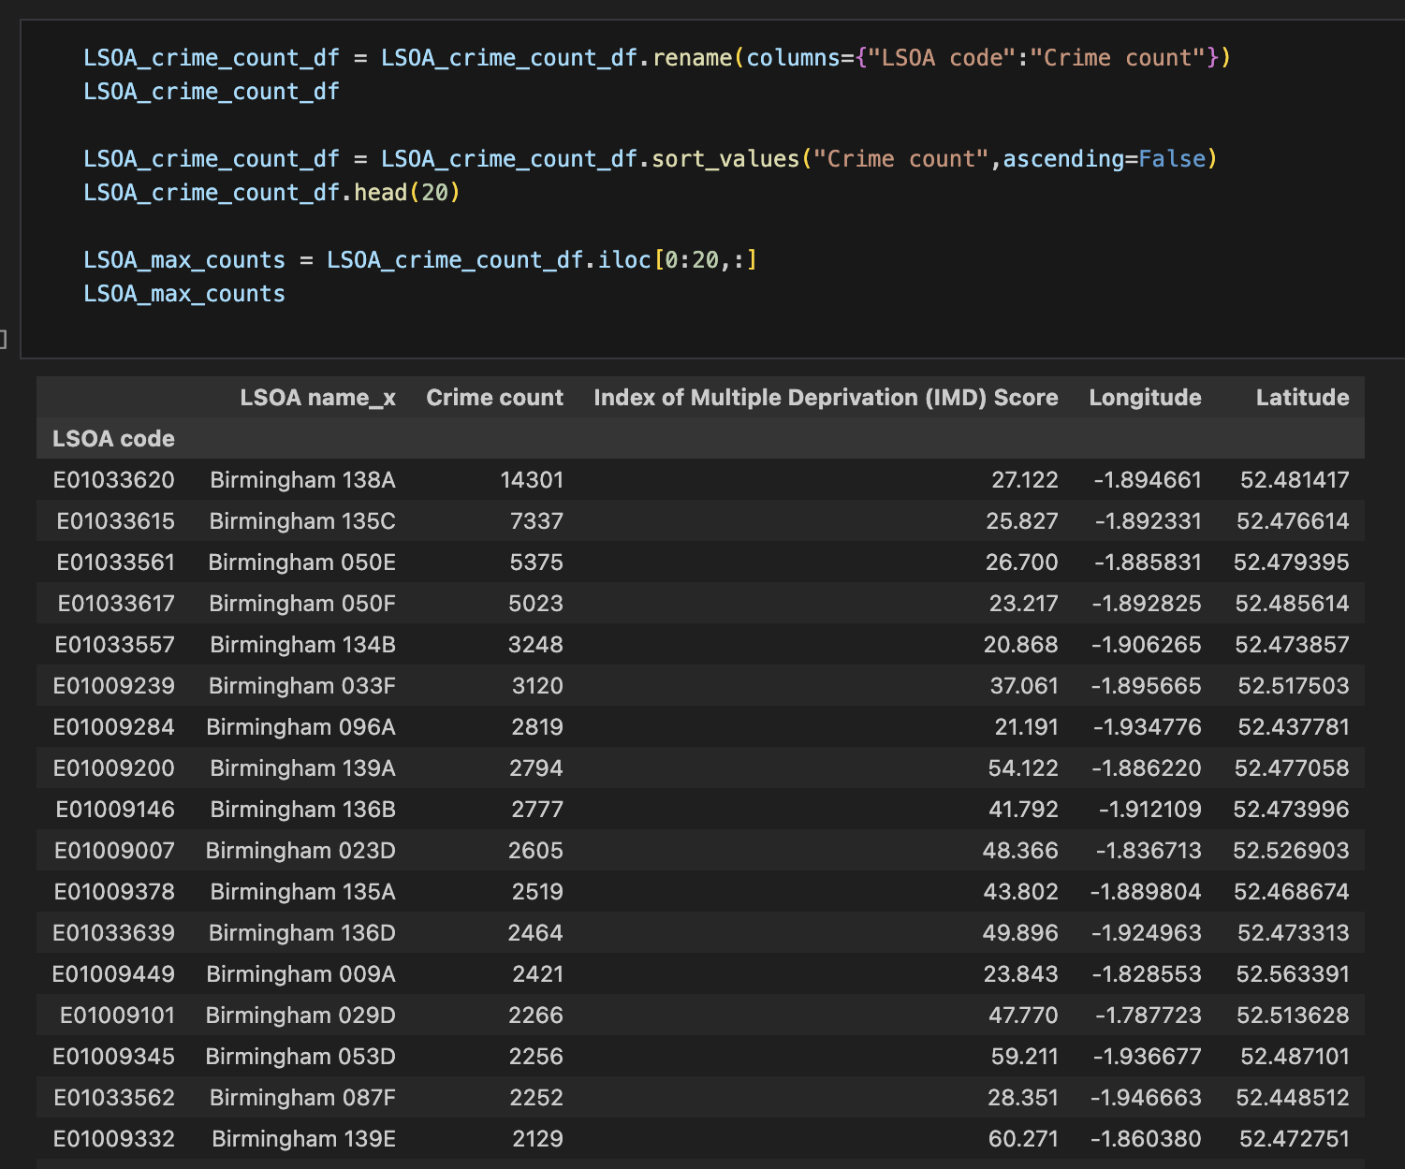
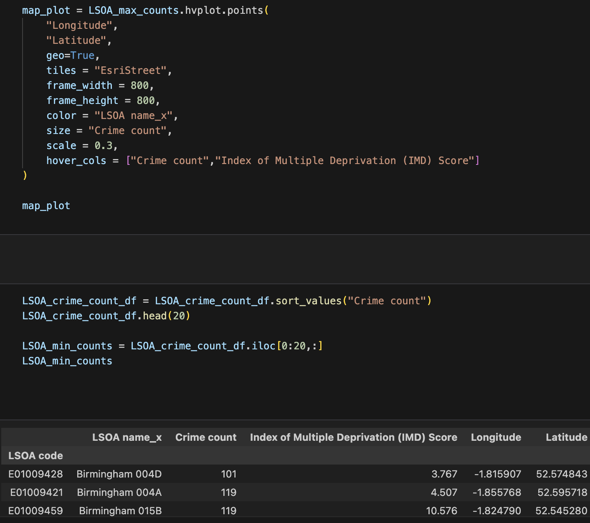
Data analysis process

Slide 25
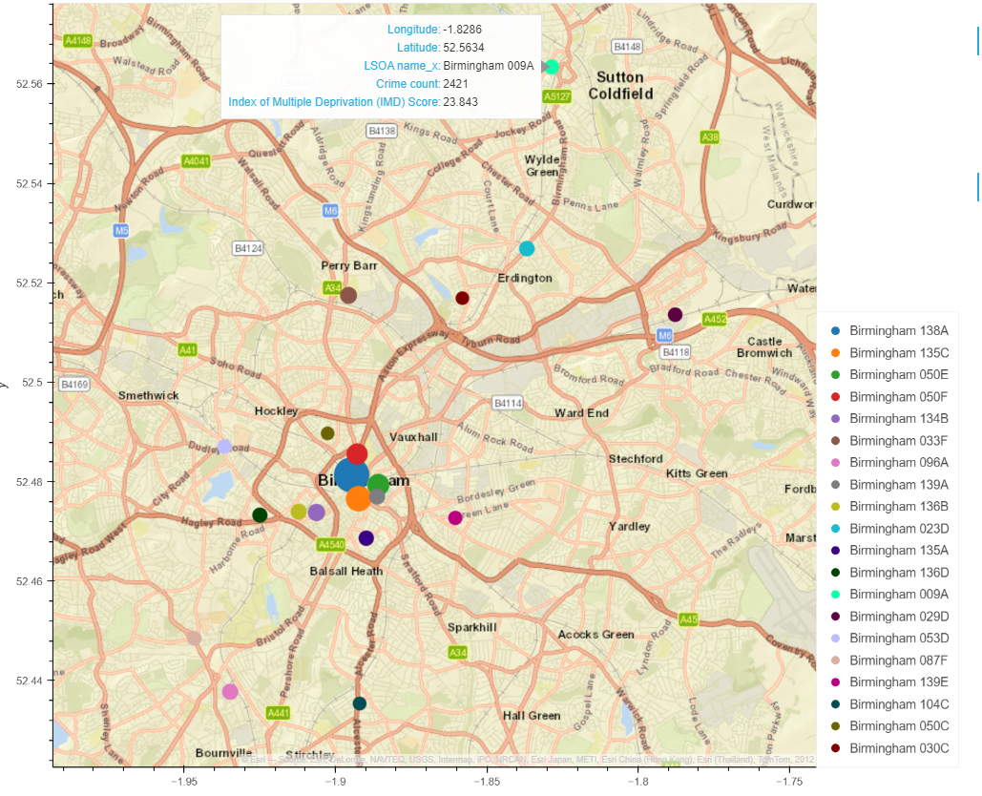

Slide 26
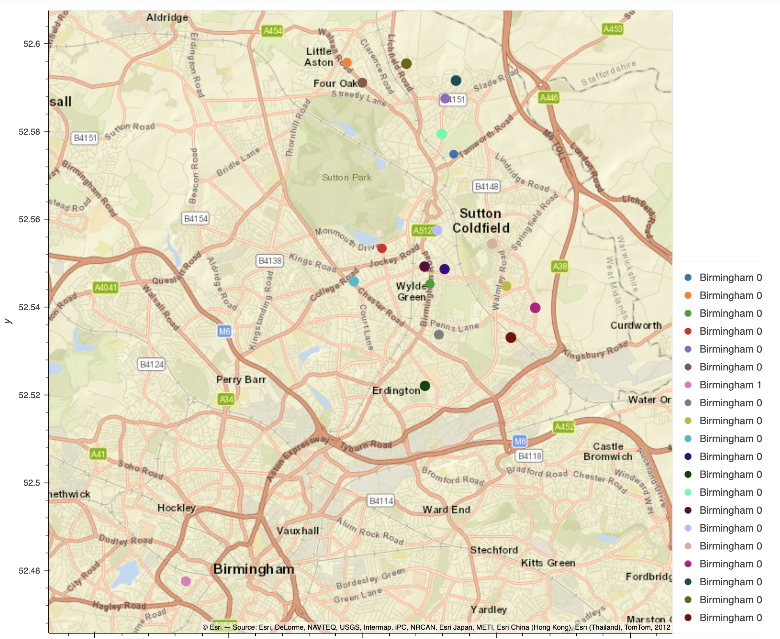

Slide 27
Research Question 4
Do crime rates exhibit seasonality, with lower street crime rates during winter months (November to February) compared to summer months (May to August)?
Hypothesis: There will be lower street crime counts during the winter months compared to the summer months.

Slide 28
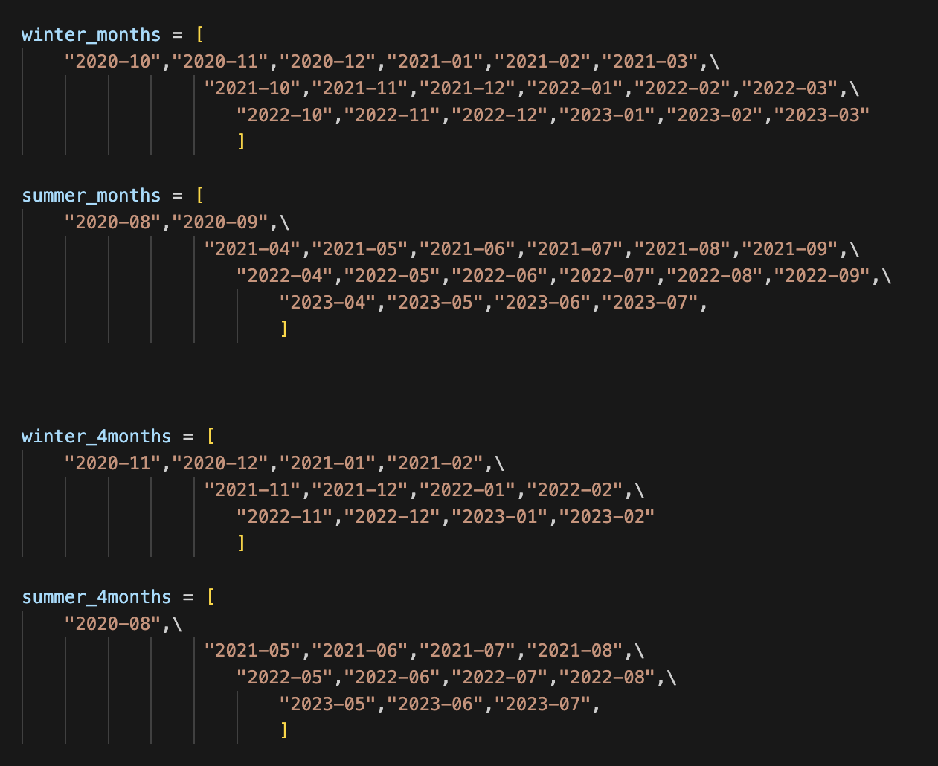
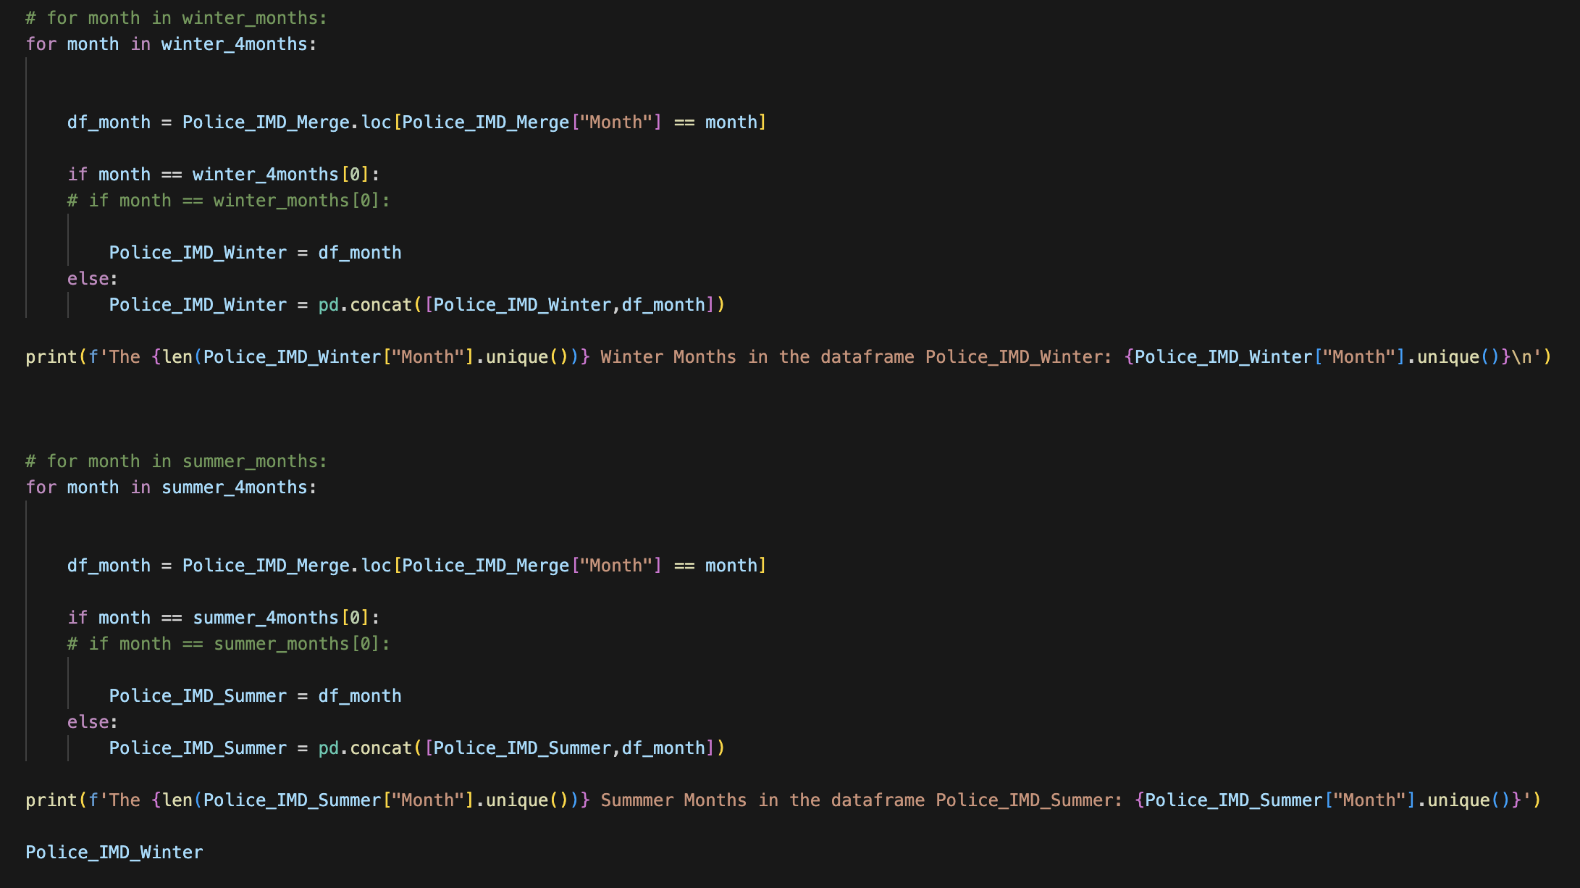
Data analysis process

Slide 29
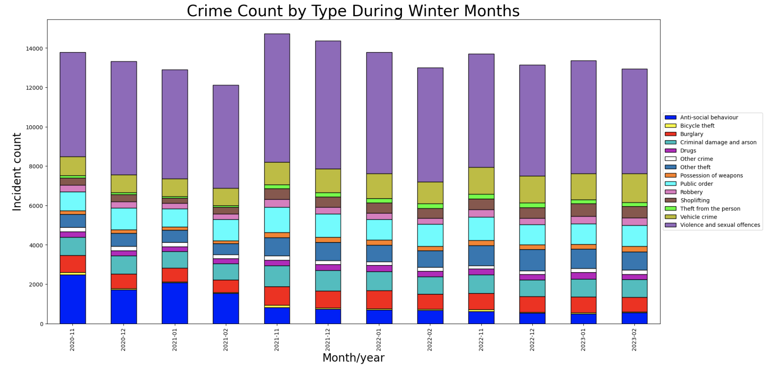
Winter

Slide 30
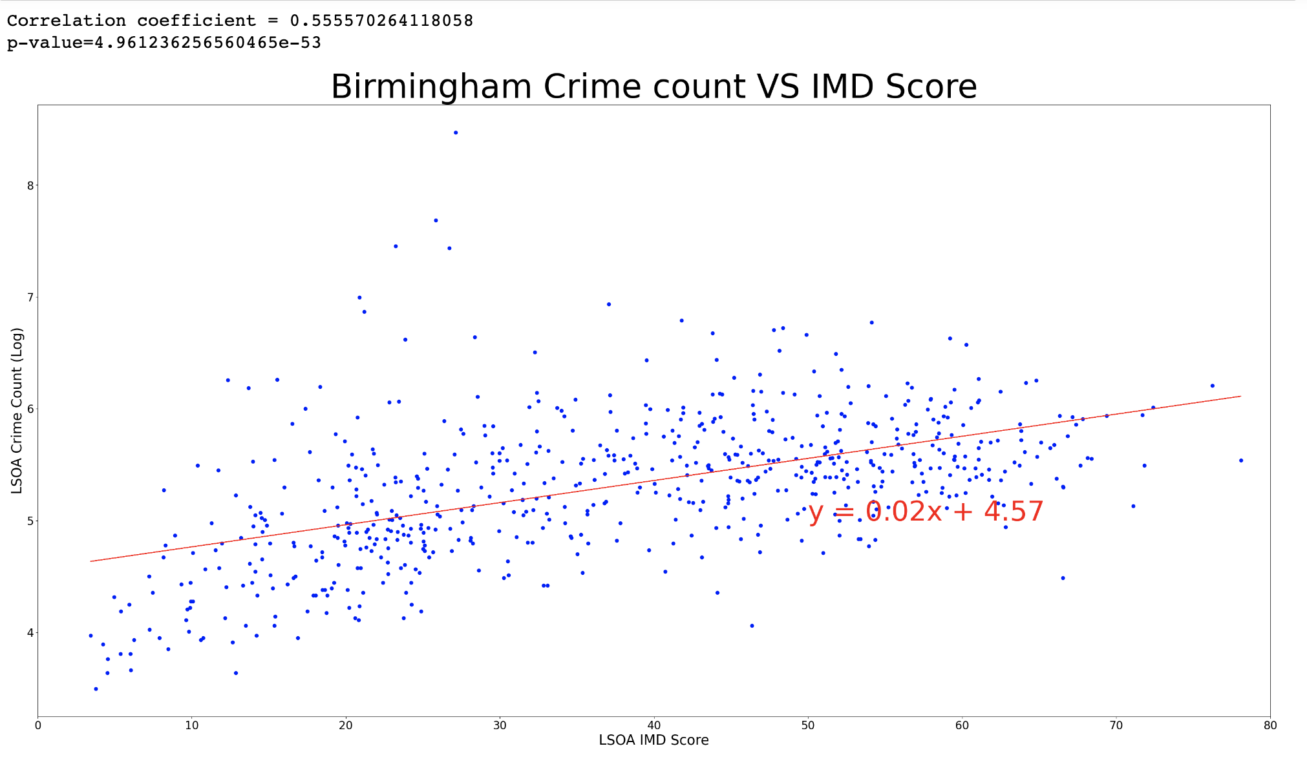
Winter

Slide 31
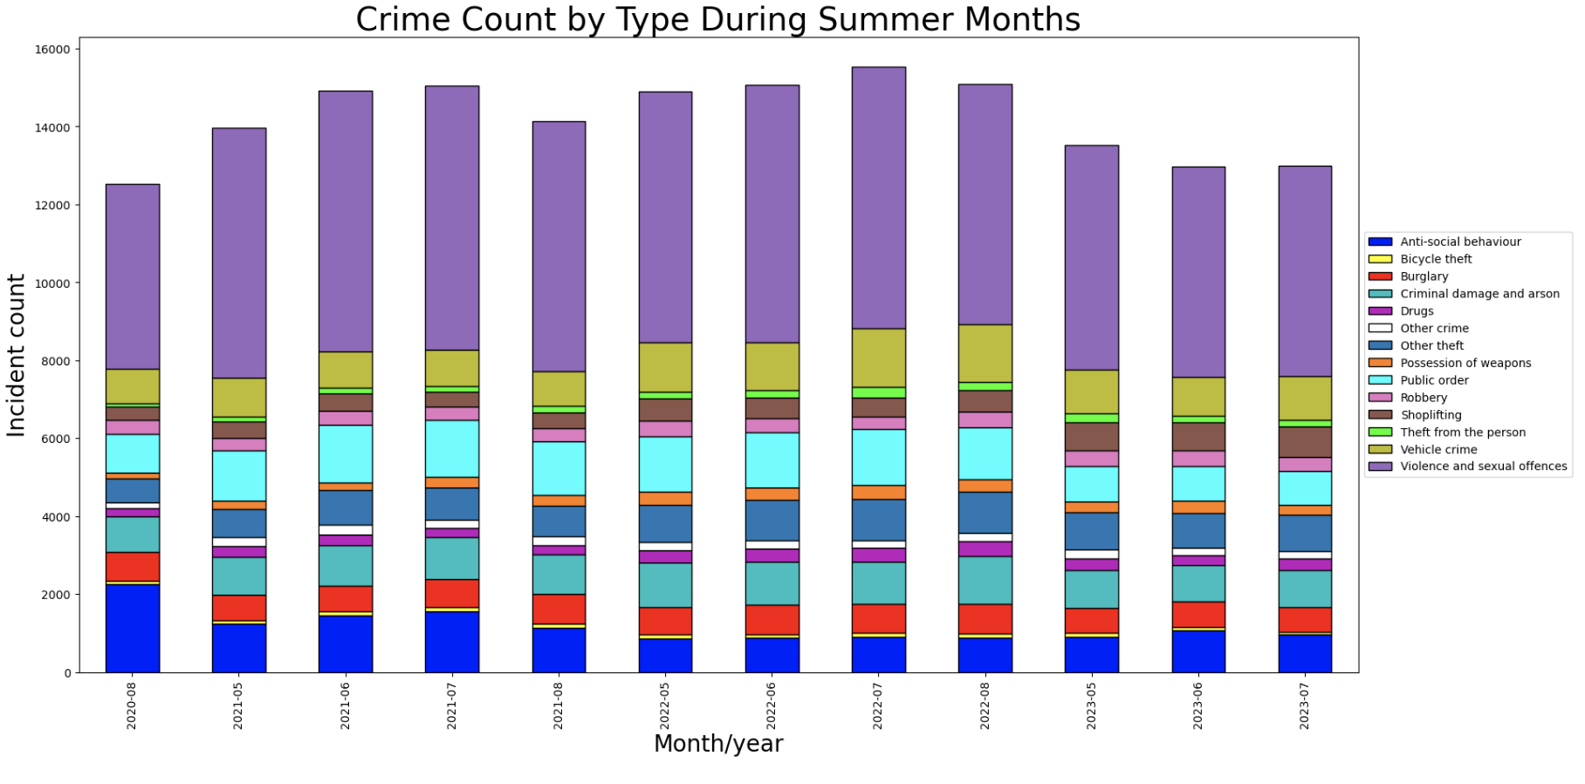
Summer

Slide 32
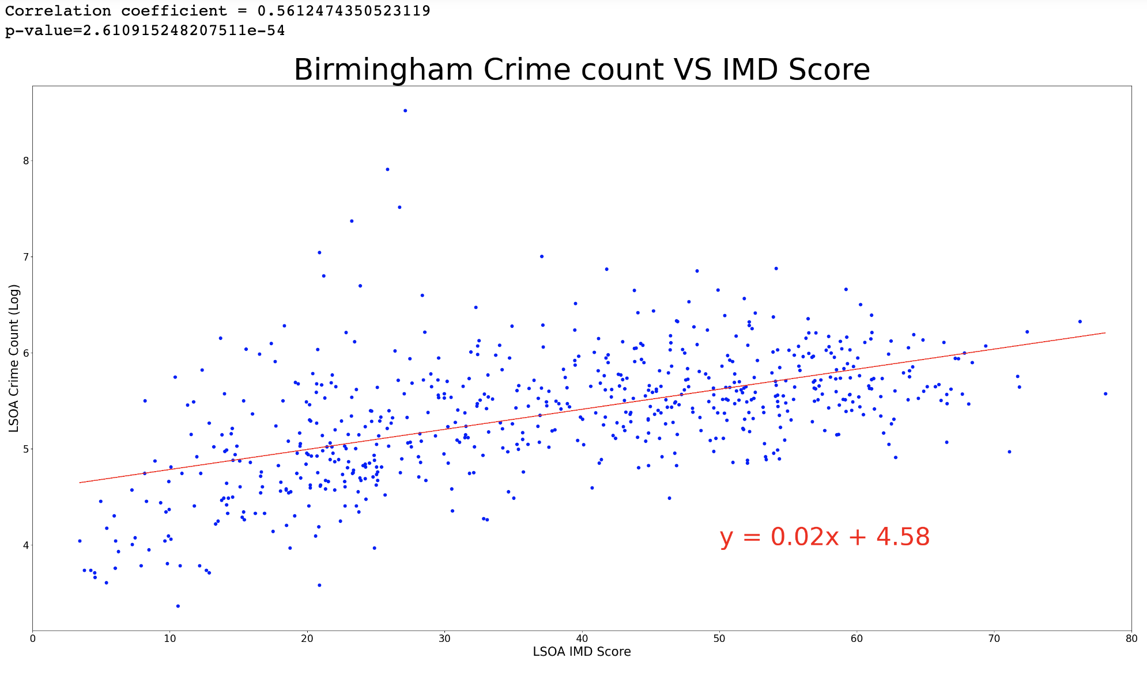
Summer

Slide 33
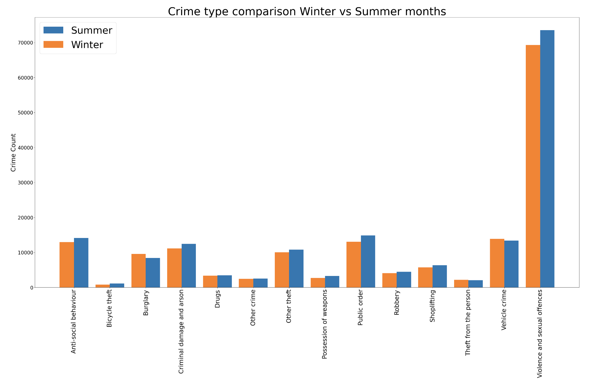

Slide 34
Conclusions
Birmingham has 30 Police Stations across the city.
The police data shows a record of 14 different street crime types.
Our findings show that IMD scores alone cannot be used to determine the crime count in an area, other factors factors such as proximity to the city centre and and type of crime play a role as well.
The city centre of Birmingham and neighbouring inner-city suburbs claim the majority of crimes committed.
Several LSOAs in the top 20 are located away from the city centre although these locations are in close proximity to the town centre.
Violence and sexual offences make up the majority of crimes committed throughout the year.
There is no significant variation in crime count across crime types over the three years.
The summer months experience a slightly higher count of crimes than winter.

Slide 35
Thanks for listening Questions?

Slide 36
